Slide 1
Master UFO Programme - A structured system for success

Slide 2
Why MUFO? Who is it for? How to guide your UFO to start the MUFO Programme?
Master UFO Programme - A structured system for success

Slide 3
Why MUFO? Who is it for? How to guide your UFO to start the MUFO Programme?
Master UFO Programme - A structured system for success

Slide 4
- Good reference for UFOs to use - To differentiate those UFOs who work the proven business development systems from those who do not - To determine what a Master UFO could earn if they implemented the proven system versus those who do not
Master UFO Programme - A structured system for success
Why MUFO?

Slide 5
- Everyone has choices - Everything in your life is a reflection of a choice you have made - If you want different results, you have to make a different choice - The programme was developed by examining what successful UFOs did in order to become successful - Every Million Dollar Club member is a qualified Master UFO
Master UFO Programme - A structured system for success
Why MUFO?

Slide 6
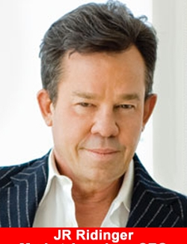
The Essence of UFO Programme
“ Everyone is looking for the keys to success.
When I was a Distributor, I didn’t care what it took or how hard I had to work. I just wanted to know exactly what I had to do to be successful.
I didn’t want to learn by trial and error or work hard and not make it. I wanted to know if I did certain things, I would make it.
The UFO programme clearly defines what you must do to become an accomplished UnFranchise® Owner — a true professional

Slide 7
Why MUFO? Who is it for? How to guide your UFO to start the MUFO Programme?
Master UFO Programme - A structured system for success

Slide 8
Who is a Master UFO?
Master UFO Programme - A structured system for success
A Master UnFranchise® Owner is a qualified
and active Independent UnFranchise® Owner (UFO) who has made the commitment to master the
UnFranchise® Business Development System
by implementing the established tasks, activities, and practices as set forth and defined in the
Master UFO Programme

Slide 9
Who is it for ?
A true Market Singapore® professional
Successful individual who simply did what the individual who did not succeed did not do
People who want to receive recognition for working the business as a true professional
People who want to increase their probability of success
Master UFO Programme - A structured system for success

Slide 10
Why MUFO? Who is it for? How to guide your UFO to start the MUFO Programme?
Master UFO Programme - A structured system for success

Slide 11
L.E.A.D.
Master UFO Programme - A structured system for success
How to guide your UFO to start the MUFO Programme?

Slide 12
Master UFO Programme - A structured system for success
L.E.A.D.

Slide 13
Master UFO Programme - A structured system for success
L.E.A.D.
EMPOWER THEM

Slide 14
Master UFO Programme - A structured system for success
L.E.A.D.
PACE WITH THEM

Slide 15
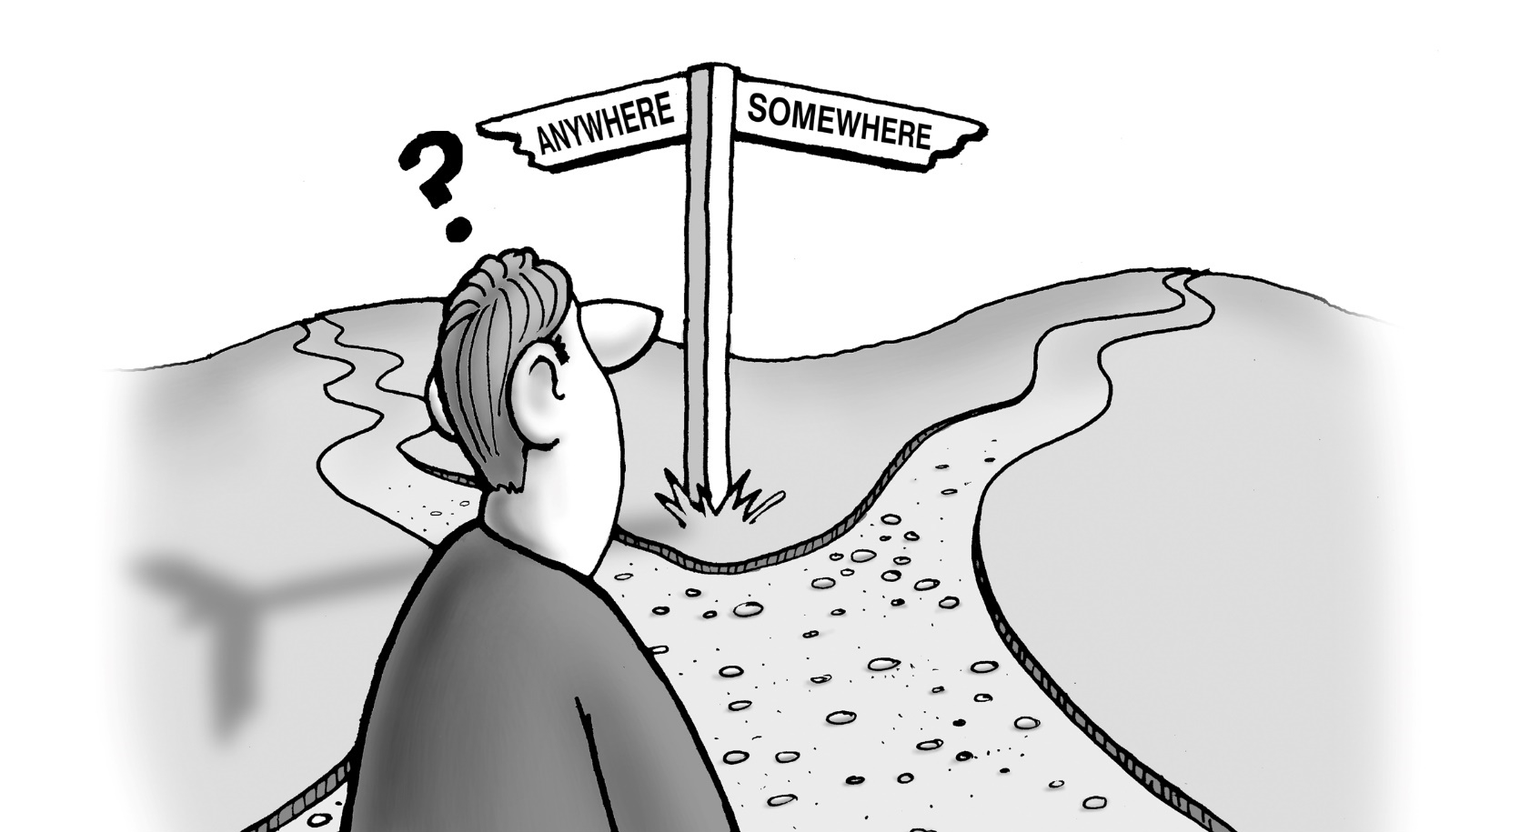
Master UFO Programme - A structured system for success
L.E.A.D.
DETERMINE THEIR “WHAT IS IT”

Slide 16
Success is a journey, not a destination.
The journey of a thousand miles begin with a single step and building your UnFranchise Business will proceed in the same manner.
If you work the MUFO system, the MUFO system will work for you
Are you willing to make a commitment to yourself and the Master UFO Programme by taking ACTION??

